Slide 1


Statistical Analysis
-
Free Tools and Techniques
Gideon Alake

Slide 2
Welcome
Welcome to the workshop on statistical analysis!
This session will cover the basics of using free tools for data analysis.
We'll explore the capabilities of well-known tools like Excel, RStudio, and Python.
Get started on your journey towards better decision-making with data!

Slide 3

Excel - Your Data Partner
1
Role
2
Understanding Excel's Capabilities
3
Mapping in Excel
Excel is an essential tool for data handling and analysis. It allows you to perform various operations on data like filtering, sorting, and searching.
Get an overview of how to build maps and charts with data to facilitate insights and highlight trends.
You'll learn how to prepare data for analysis with Excel tools, including data validation, naming conventions, and transformations. Scraping data from the web is also a breeze with Excel!
4
Excel Add-ins
Enhance your Excel experience with add-ins like Solver, which can help you solve complex optimization problems and create custom functions for your unique needs.

Slide 4
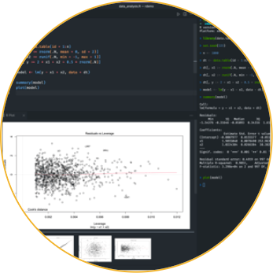
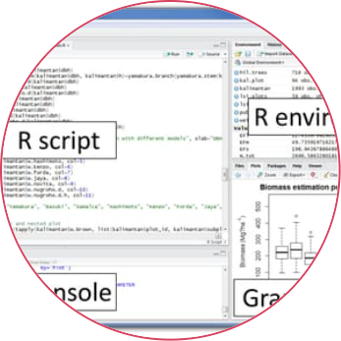

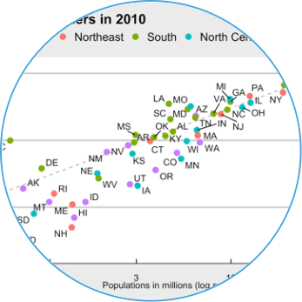
RStudio - A Comprehensive Analysis Tool
Credentials and Features
Basic and Advanced Data Analysis
Linux Programming
Data Visualization with RStudio
RStudio is a powerful free tool that utilizes the R programming language. Its features include importing data, computation, and visualization.
Learn how to code with Linux in RStudio effortlessly. This feature helps to boost coding efficiency.
RStudio has excellent data visualization capabilities. It facilitates the development of custom graphics, interactive charts, and visualizations that can aid understanding and communicate insights effectively.
RStudio uses an intuitive user interface for analyzing data. Experienced data analysts can carry out advanced analysis with the help of sophisticated algorithms.

Slide 5
Good Practices for R Programming
Data Import and Preprocessing
Learn how to import and preprocess data in RStudio. These are vital aspects of data analysis and can affect the quality of the final results.
1
2
3
Object-Oriented Programming
Packages and Libraries
RStudio facilitates object-oriented programming and allows for the reusability of code for efficient programming.
RStudio has a large community of developers who have created packages and libraries that can extend its functionality, so there's no need to reinvent the wheel.

Slide 6
Further Enhancements with RStudio Add-ins
Code Snippets
Shiny
R Inside Tableau
RStudio code snippets facilitate efficient coding with pre-defined templates for repeated code blocks.
A web application framework for R, Shiny can help you create interactive apps effortlessly. Without needing to use web technologies like HTML, CSS, or JavaScript.
Using R Inside Tableau, you can create interactive and comprehensive data visualizations in Tableau's drag-and-drop interface.

Slide 7

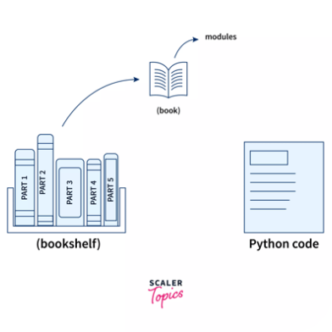
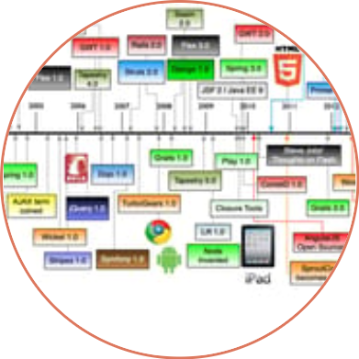
Integrating Python in RStudio
Features of Python in RStudio
Python Libraries in RStudio
Python Web Frameworks
Learn how to use Python with RStudio to enable a comprehensive analysis experience. Features include easy integration, machine learning, and data visualization.
There are a multitude of well-documented Python libraries that can expand the capabilities of RStudio, including Pandas, Numpy, and Scikit-learn.
Learn to integrate Python web frameworks like Django and Flask for developing web applications within RStudio.

Slide 8
Final thoughts
1
Think Beyond Excel
2
Make Full Use of Libraries and Add-ins
3
Always Practice Good Data Preparation
Free tools like RStudio and Python can enable a much more comprehensive analysis and visualization experience.
There's no need to create everything from scratch; plenty of libraries and add-ins can provide extended functionality to your existing setup.
Good preparation is the foundation of good analysis, so make sure you take your time with data validation, naming conventions, and transformations.

